Slide 1
Team software Process
MIEIC: ESOF
Class 1 – Group F
Diogo Peixoto Pereira – up201504326
Maria Eduarda Santos Cunha – up201506524
Pedro Miguel Ferraz Nogueira da Silva – up201505460

Slide 2

Team software process (TSP) is a software development strategy developed in 1996 by Watts Humphrey.
Watts Humphrey

Slide 3
TSP is a software development strategy that provides a well defined process framework designed to:
show managers and engineers how to build self-directed teams;
plan and manage their work;
coach and motivate their teams;
sustain peak performance;
produce software products in a way that improves the quality and productivity of the team.

Slide 4
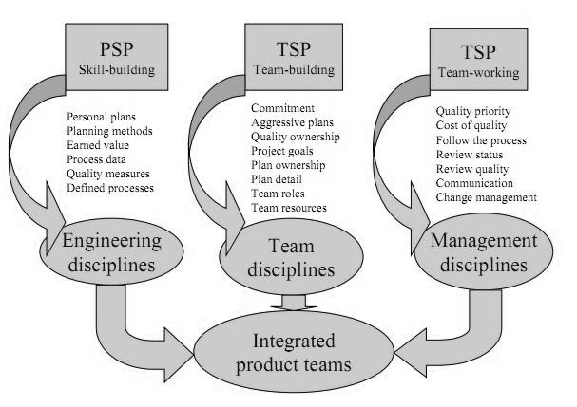
To really understand TSP, engineers must be trained in the personal software process (PSP), in which they learn how to gather and use process data, make detailed plans, manage product quality as well as using earned value to find a project. The main elements of TSP can be summarize in this figure:
TSP Main Elements

Slide 5
TSP divides the team in various roles with specific functions:
Team leader
Design manager
Team coach
Support manager
Quality manager
Implementation manager
Planning manager
Test manager

Slide 6
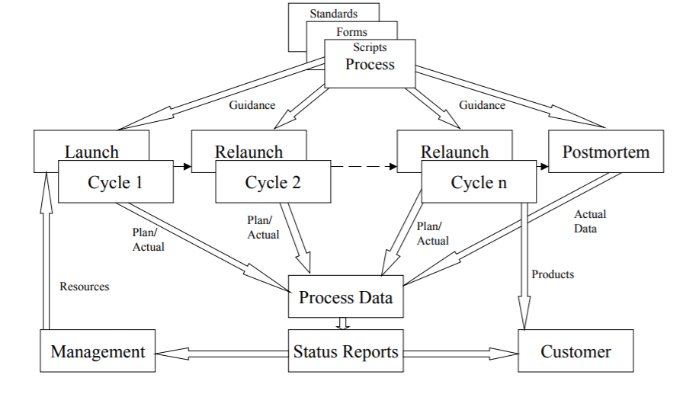
The TSP consists of 6 major phases: 1. Launch; 2. Requirements; 3. High level design; 4. Implementation; 5. Release test; 6. Post mortem.
TSP Process Flow

Slide 7
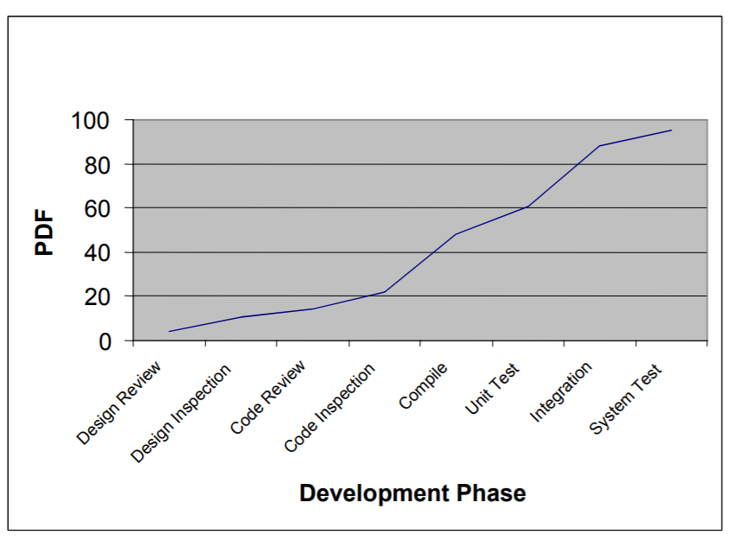
The quality of a project is an essential part of it. The TSP shows teams how to manage quality, by: 1. Making a quality plan; 2. Identifying quality problems; 3. Preventing quality problems.
PDF plot

Slide 8
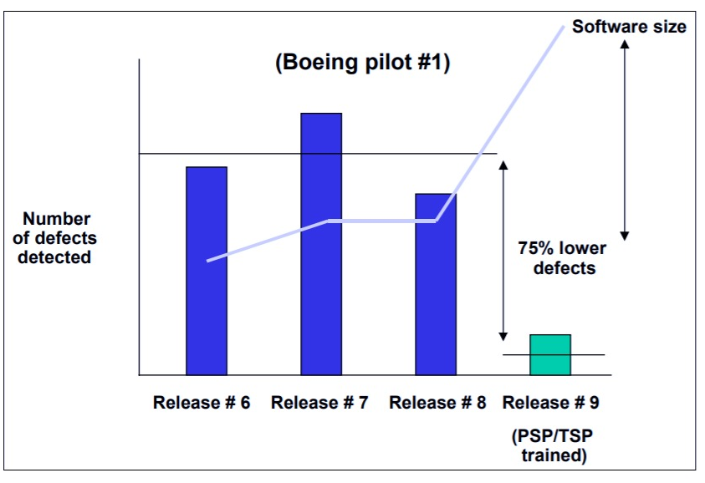
TSP is being introduced into both industrial and academic environments. Some examples of projects where TSP was successfully used are: 1. Teradyne; 2. Hill air force base; 3. Nedbank; 4. Beckman coulter; 5. Boeing.
TSP Test Defects

Slide 9
TSP has many proven benefits…
…but also some cons:
Improved size, effort and schedule estimation;
Improved productivity;
Better defect detection;
High quality products.
Need to do a lot of plans that have to be strictly followed;
Wastes a lot of time in weekly meetings;
Lot of thinking before the actual work;
Constant management’s pressure to team members.

Slide 10
Without a doubt, TSP is a software development strategy that differentiates from others because of the main role a team has in the software development. More than focusing on the individual, TSP forms a strong team with well defined roles, in order to produce the best software possible for the clients it attends.

